Slide 1


The Brain and the Ear
From Neurons to Nerds Like Us
Brain Awareness Week
Mark Rudolf
Notes:
Health and medical sciences academy -> emphasis on the sciences as BUILDING BLOCKS for a future in healthcare
-> even I am not far enough along to really memorize the dosages of drugs
-> what you all need at this point is to hit the fundamentals hard and build the foundation for your future.
Realize that being called a “nerd” is a compliment!!!!!!!

Slide 2
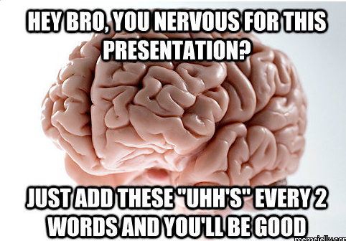

Slide 3


Agenda
Clinical Neuroscience
Who cares?
How do clinicians assess?
Physical Exam
Questioning
How do neurologists localize lesions?
Neuroscience Research
What don’t we know?
How do we study it?
My research: THE EAR

Slide 4

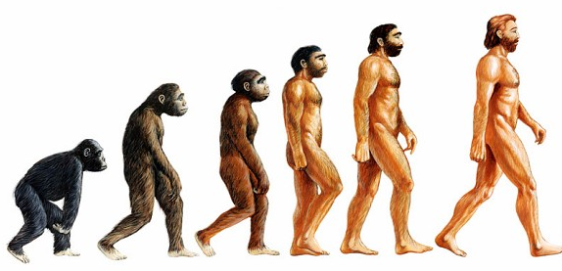
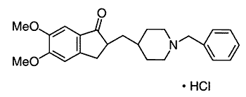
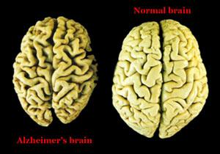
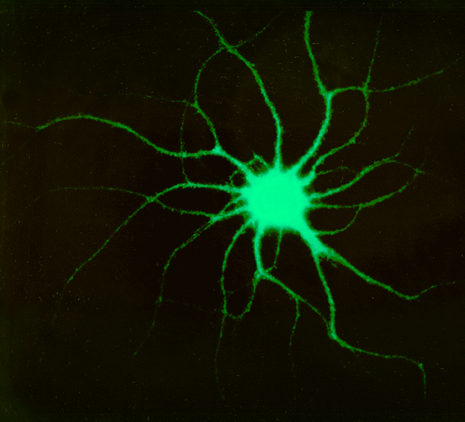
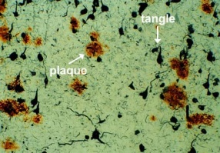
Cells to Society: Studying the Brain
Populations
Organisms
Molecules
Epidemiologists
Psychologists
Basic Scientists
Organs
Cells
Clinicians
Tissues

Slide 5

Clinical Neurology
Neurosurgeons
Anesthesiologists
Neuroradiologists
Psychiatrists
Neuropathologists
Neurologists
…Basically all specialties

Slide 6
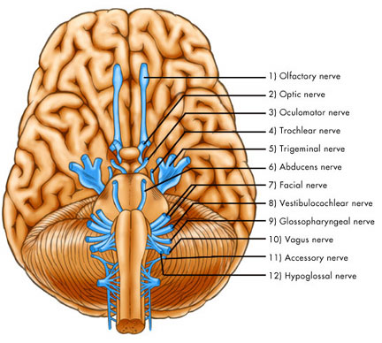
Our Bread and Butter: Cranial Nerves
Notes:
Picture of the 12 cranial nerves

Slide 7
CN I – Olfactory Nerve
Olfaction = sense of…

Slide 8
CN II – Optic Nerve
Swinging light test
Look for PERRL

Slide 9
CN III, IV + VI –
Oculomotor nerve
Trochlear nerve
Abducens nerve
Motor components of eye
H-test
Accomodation

Slide 10
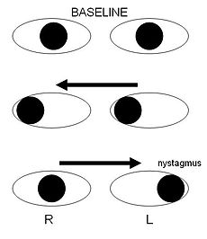

INO – A key presentation of MS
Notes:
Link to YouTube video of INO: https://www.youtube.com/watch?v=tIOyFsBwUuY

Slide 11
CN V – Trigeminal Nerve
Sensation to face
TRIgeminal -> 3 parts
Shingles
WARNING: DISTURBING IMAGE

Slide 12
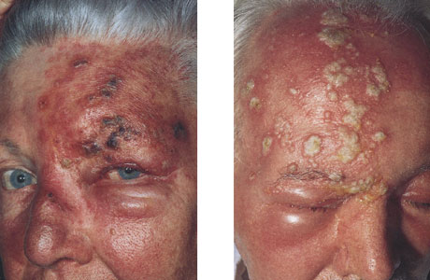
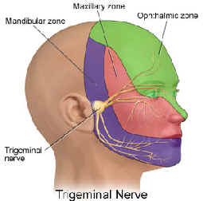
Shingles – The Chicken Pox Returns!

Slide 13
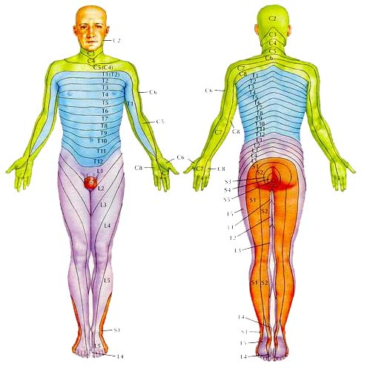
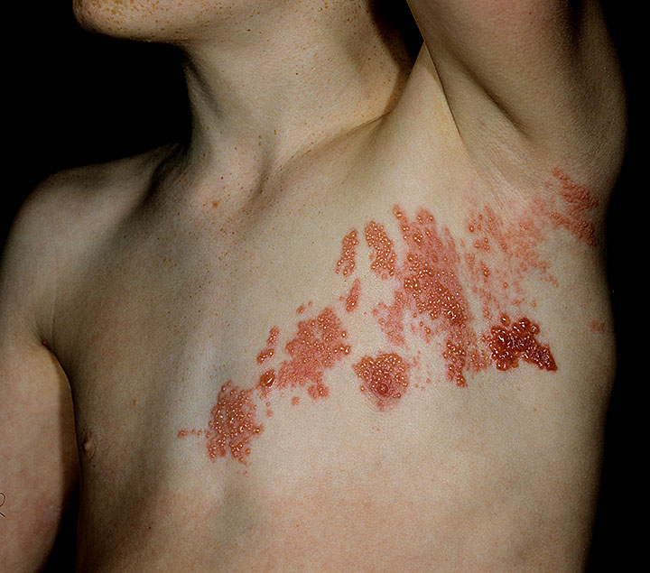
Shingles follows Dermatomes
Herpes zoster virus stays latent in nerves, re-emerges if immunity weakens

Slide 14
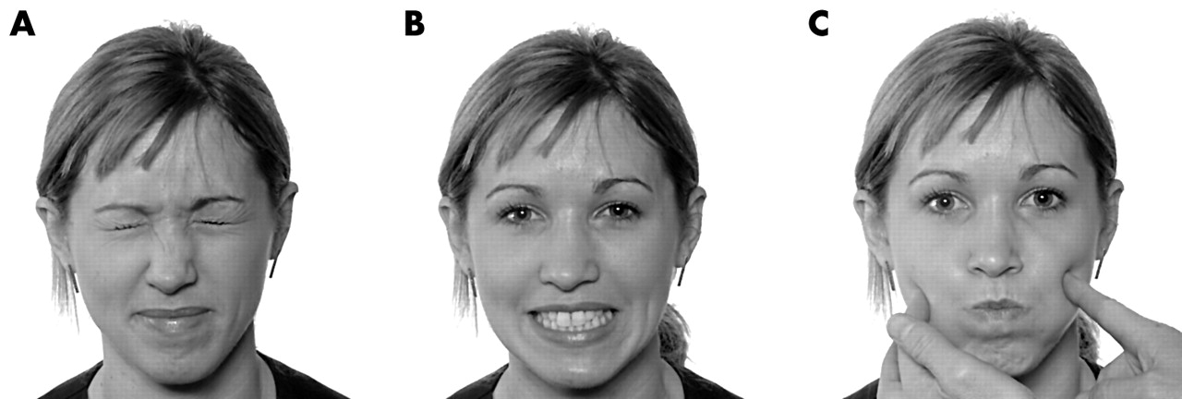
CN VII – Facial Nerve
Facial Expressions (motor to face)

Slide 15
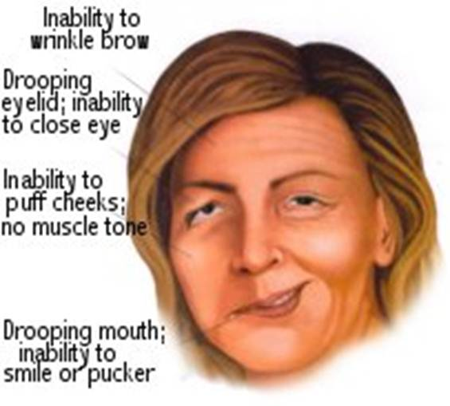
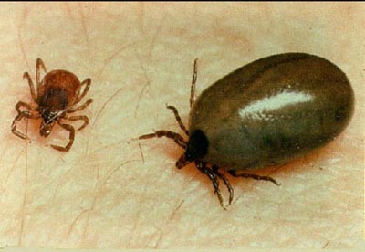
Ticks -> Lyme Dz -> Bell’s Palsy

Slide 16
CN VIII – Vestibulocochlear Nerve
Vestibular -> Balance
Cochlear -> Hearing
Finger rub

Slide 17
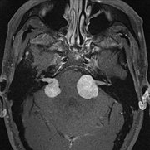
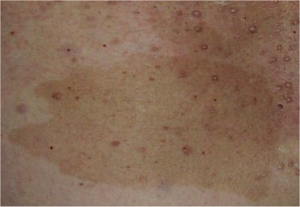
Neurofibromatosis

Slide 18
CN IX, X –
Glossopharyngeal Nerve
Vagus Nerve
Say ahhhhhhh
Notes:
Farside Comic – what’s that thing in the back of the throat?

Slide 19
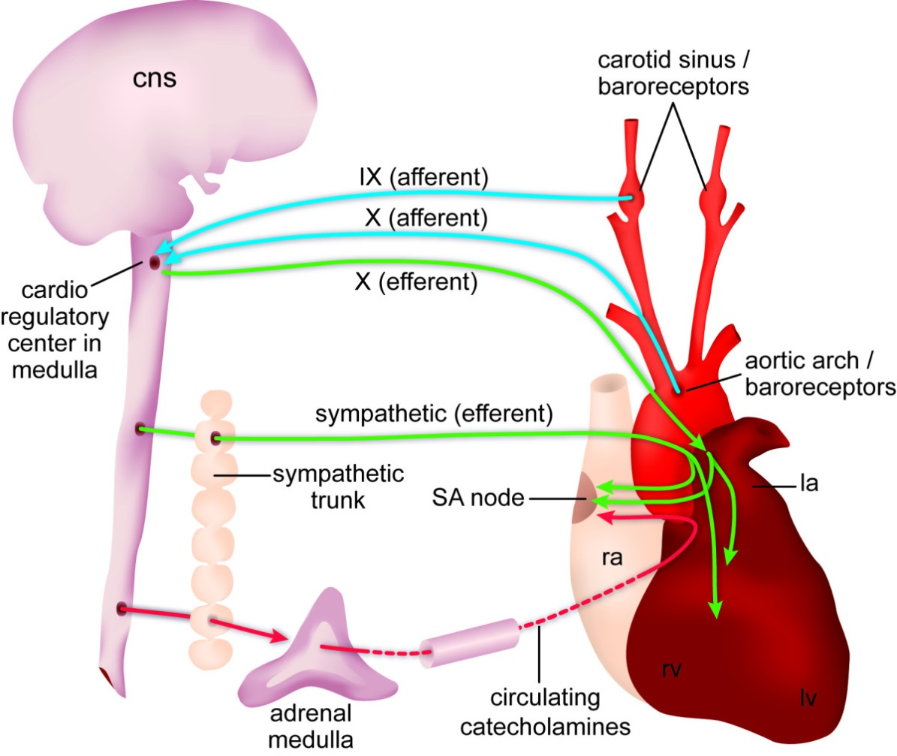
Baroreceptor Reflex

Slide 20
CN XI – Spinal Accessory Nerve
Shrug Shoulders
Sternocleidomastoid
Cervical dystonia -> BOTOX
Which side to inject, left or right?
Notes:
TANGO NECK -> You look AWAY from the muscle that contracts

Slide 21
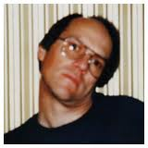
Cervical Dystonia

Slide 22
CN XII – Hypoglossal Nerve
Tongue side to side

Slide 23
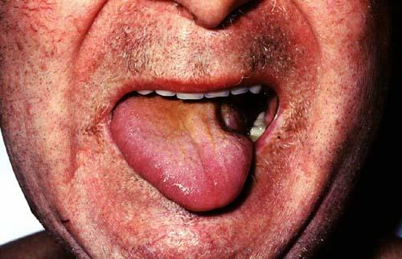
CN 12 Palsy

Slide 24
Case 1
76 year old female smoker with history of high blood pressure is slurring her speech when she talks with her daughter over the phone. She presents with acute onset left facial droop.
What is the most likely diagnosis?
What cranial nerve is affected?
Where did the “lesion” occur?
Advanced age + smoking + high blood pressure = STROKE!
Cranial Nerve 7 – Facial Nerve
Brainstem (pons)or along the path of the nerve

Slide 25
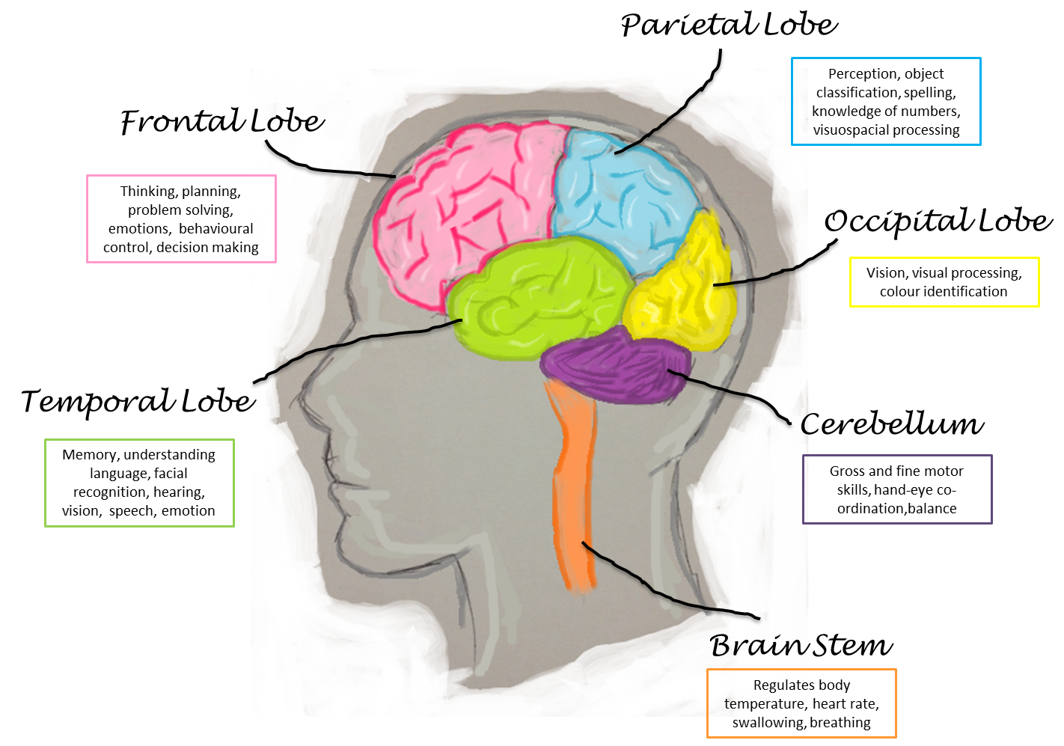
Lobes and their Functions
Spelling Backwards
Orientation: Date
Remember 3 words: Grass, Rose, Boy
Romberg Test
What were those 3 words???
Notes:
Frontal Lobe Q: Where are you right now. Doing a puzzle. Behavior/Irritability, 1o Motor
Temporal Lobe: Memory, Speech…”Grass, Rose, Boy”
Parietal Lobe: Math, Spatial Orientation, 1o sensory….serial sevens, world backwards
Cerebellum: Coordination, Romberg
Brain Stem: ANS

Slide 26
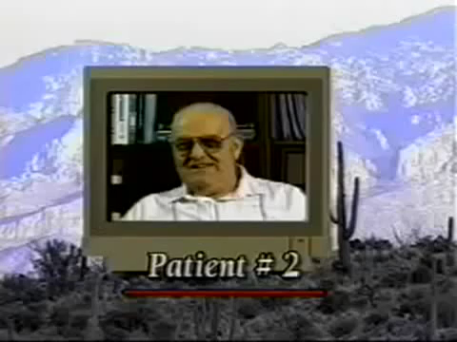
Case 2
Is he aware of deficit?
Can he understand speech?
Can he produce speech?
Is automatic speech intact?
Do you predict that he could write?
(non-classic Broca’s Aphasia - Language Production Defecit– Frontal Lobe

Slide 27
Intermission
Practice Cranial Nerves Exam
CN2: swinging light test
CN3,4,6: H test
CN5: Light touch to face
CN 7: Emoji
CN 8: Finger rub
CN9,10: Ahhhh
CN11: Shrug
CN 12: Tongue
Optional: Brain Facts Worksheet
Check out a real brain!

Slide 28
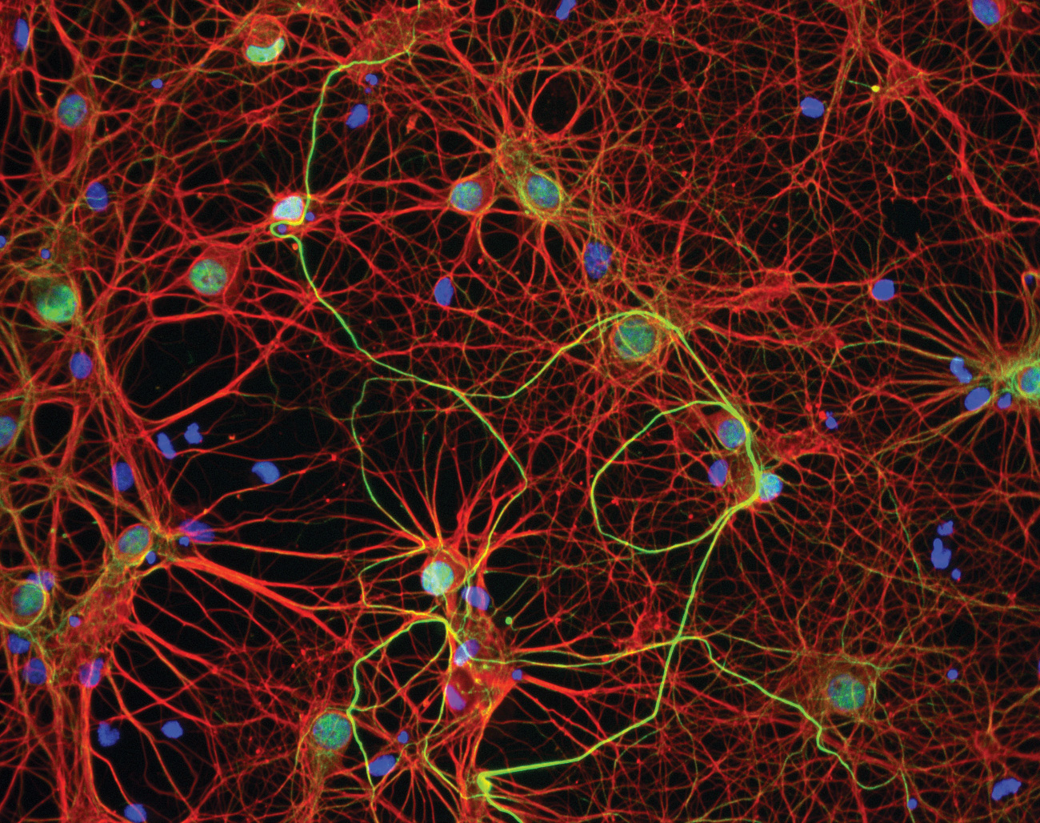
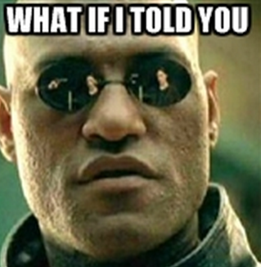
The Brain Is Complex
Many neurons
Many connections aka synapses
How many?
Notes:
Cool picture of brainnn
What if I told you MEME

Slide 29
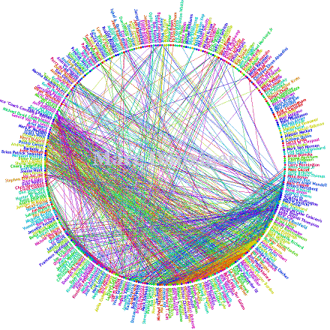
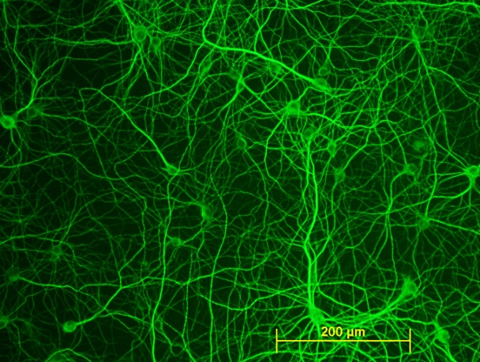


Connections: FB vs The Brain
You + 1000 FB friends
~1 Million “friendships”
1,000,000
(6 zeroes)
Brain’s 100 billion neurons
10 Sextillion possible connections
10,000,000,000,000,000,000,000
(22 zeroes)
That’s 14 Planet Earth’s of FB friendships in your head!
Notes:
Facebook like button
Can you imagine all the notifications?
Must change-> initial assumption was 1 bn neurons, not 100 bn

Slide 30
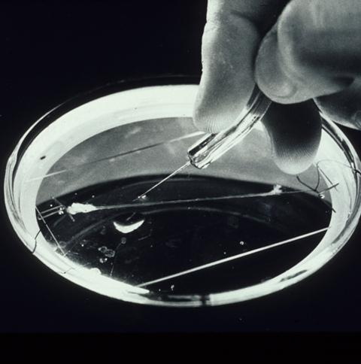
Tools for Neuroscientists
Giant Squid Axon
Study ACTION POTENTIALS
Why use it as a model?
Notes:
Why

Slide 31
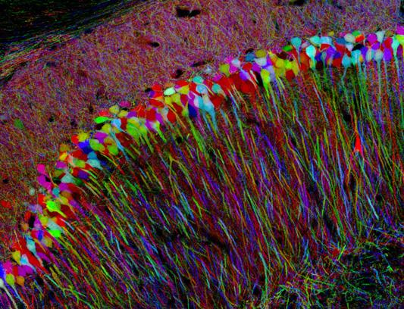
Tools for Neuroscientists
BRAINBOW
Label neurons with fluorescent proteins
Trace individual axons

Slide 32
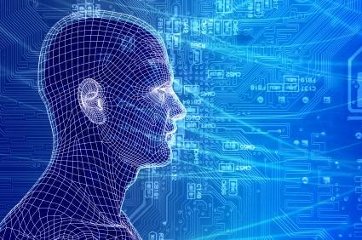
Tools for Neuroscientists
Blue Brain Supercomputer
Simulate neural networks in silico

Slide 33
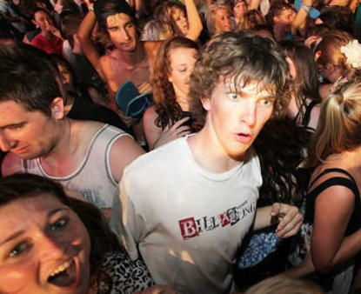
Unanswered Questions
How are all these neurons connected?
What gives rise to consciousness?
Why do we need sleep?
What happens when we learn?
Why can’t we regenerate after injury?

Slide 34
Mark’s Research on The Ear
Ready? (countdown)
3
1
6
4
10
9
8
7
5
2

Slide 35
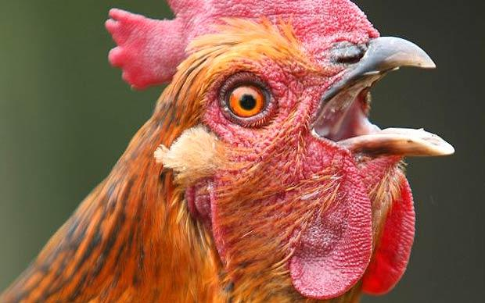
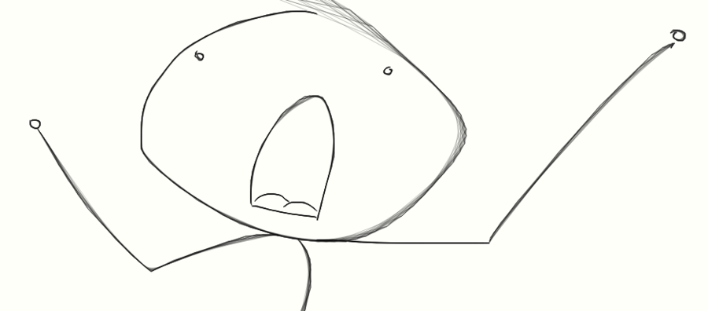
BOOM!!!
A loud noise makes a chicken and human go deaf!
The human is deaf forever,
but the chicken hears after two weeks.
Why can’t we do that?

Slide 36
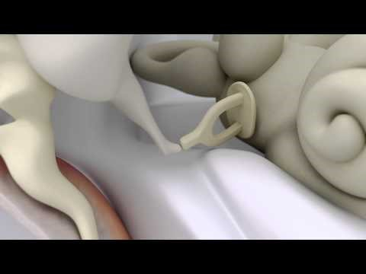

Slide 37
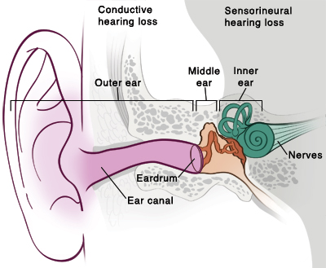
The Three Ears
and Two Types of Hearing Loss
Earwax
Perforated eardrum
Otosclerosis
Infection
Congenital malformation
Aging
Loud Noise
Antibiotics
Chemotherapy
Meniere’s disease
fairview.org

Slide 38
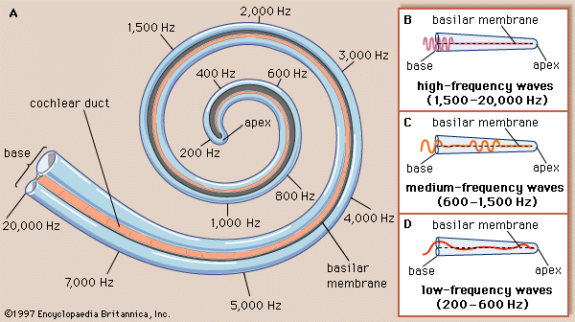

Demo: How well can YOU hear?
ASAP Science – How Old Are Your Ears?
8 kHz
10 kHz
12 kHz
14 kHz
15 kHz
16 kHz
17 kHz
18 kHz
19 kHz
20 kHz
Notes:
I’m at 17 kHz

Slide 39

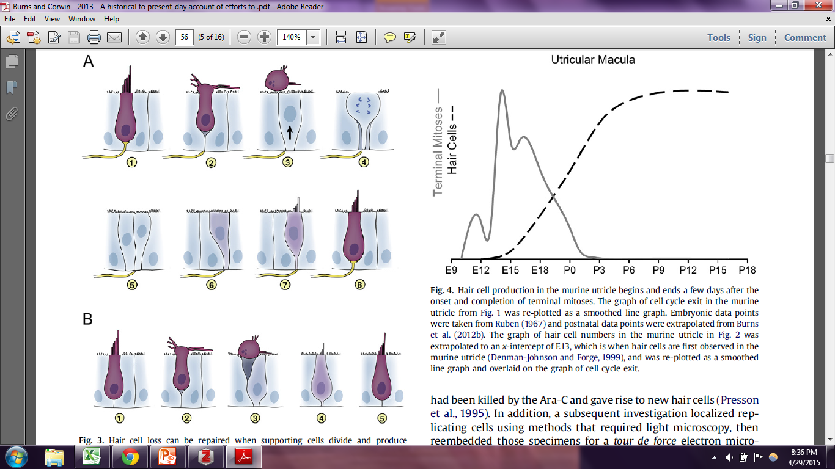
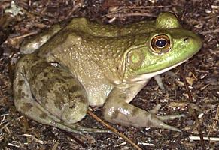

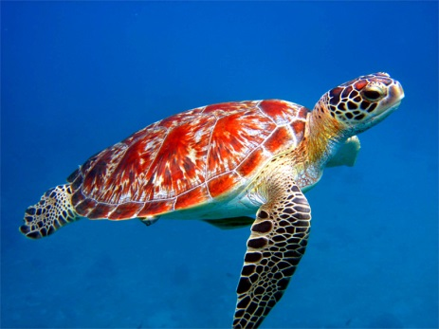
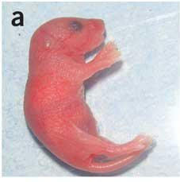
How Hearing Regen Works (in birds)
Hair cell dies, extrudes
Support cells sense damage and divide
Support cell differentiates to hair cell
These guys can regenerate hearing too!
Notes:
Boom, HC die, sc prolif, sc diff
Also reptiles, sharks, frogs…many vertebrates (and young mice!)

Slide 40
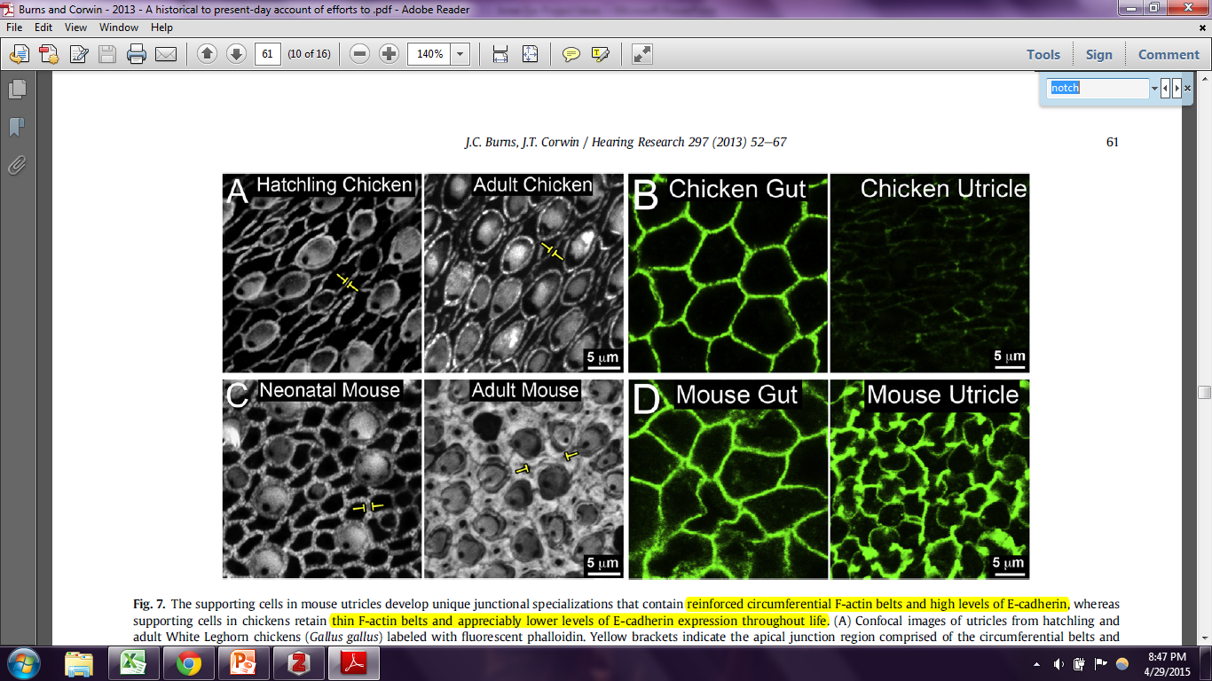
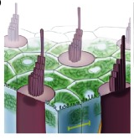
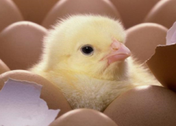
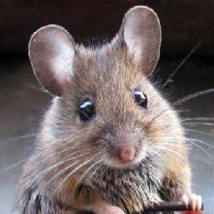
What’s Different in Mammals?
Thick apical junctions develop in older mice!
Notes:
Show junctions chicken vs mouse JOE BURNS CARTOON
AJ thickness/plasticity graph
Video of response to injury

Slide 41
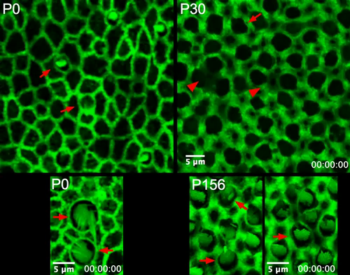
Thicker junctions restrict response to damage

Slide 42

Mechanical Signals
It’s amazing what a bit of tension can do…
-cell shape change
-cell migration
-cell proliferation
-cell differentiation
Notes:
Doorbell
Light switch
Kid tugging on mom
Someone pulling on tiger tail – it’s amazing what a little tension can do

Slide 43
Hypothesis
Reinforcement of apical junctions limits plasticity and regeneration in aging mammals.
So are we correct?
We don’t know yet!
(to be continued…)

Slide 44
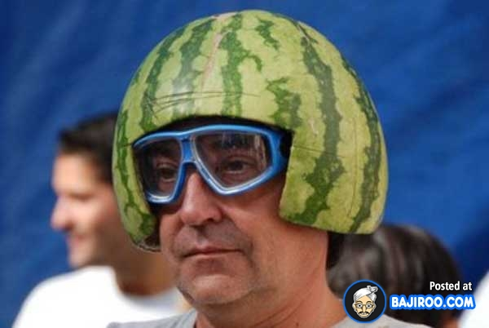
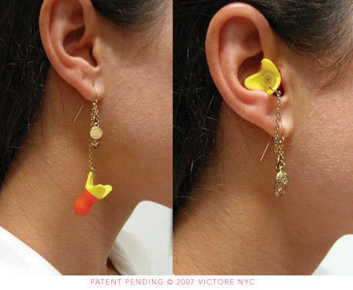
Take Home Points
Wear a helmet!
Wear earplugs at concerts!
Avoid ticks!
USE YOUR BRAIN!
Learn biology and chemistry (and math and writing and and and…) so you can help unlock the brain’s secrets one day!
Notes:
Meme of bike fall fail?

Slide 45
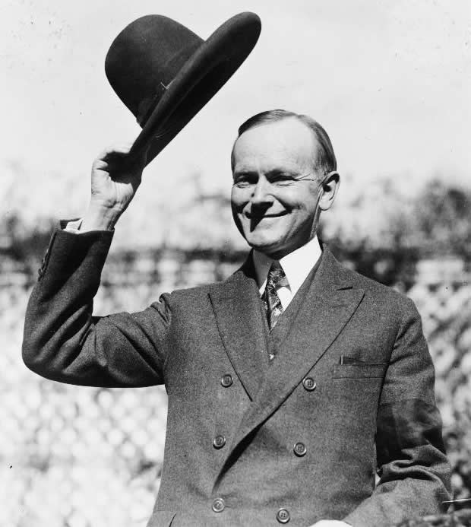
Acknowledgements
HMSA Staff
Karen Ye
Katina Dudley
Lab Members
Jeff Corwin
Anna Andreeva
Lorela Ciraku
Ben Thiede
Joe Burns
UVA Neuroscience
UVA Med
UVA MSTP
NIH

Slide 46
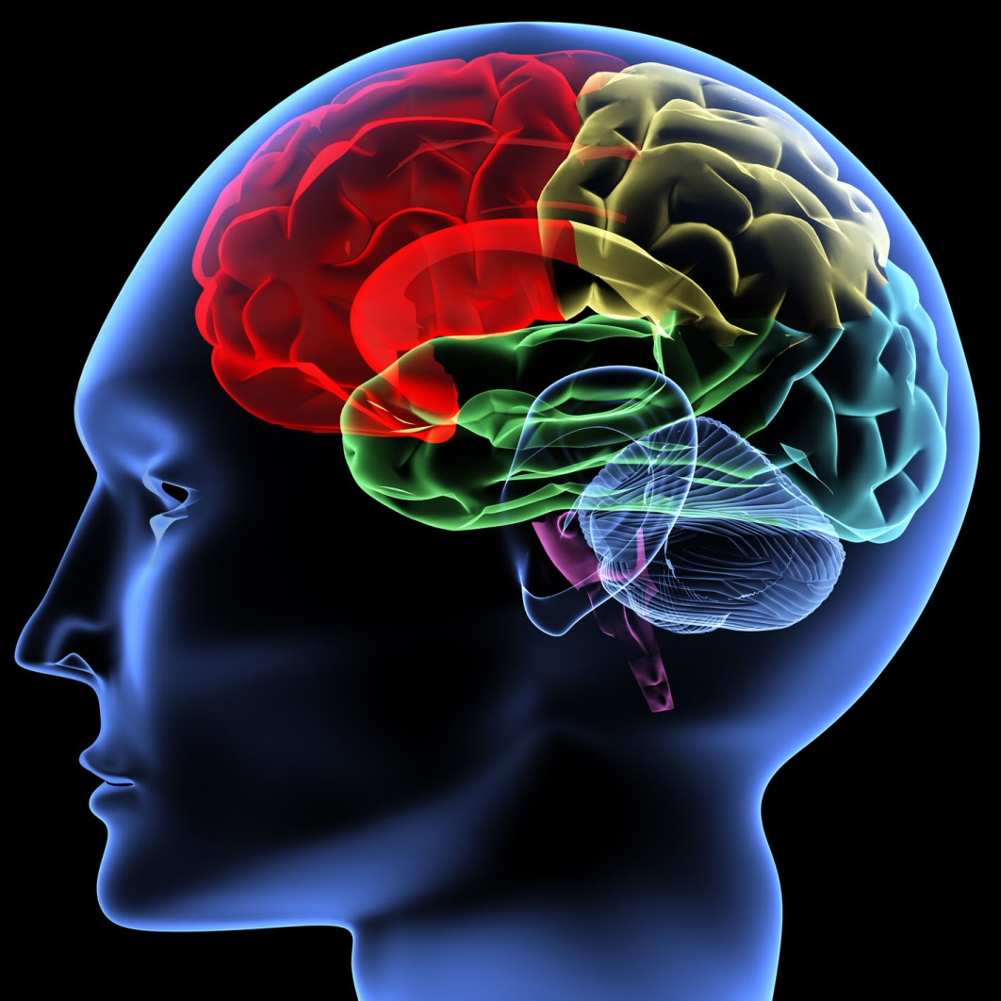
Thanks!!!
Good luck and always ask questions!

Slide 47
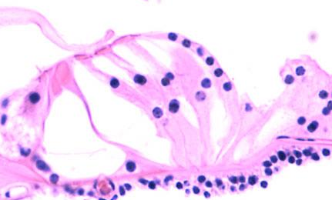
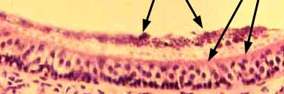


The Sensory Epithelium
Cochlear
More specialized
More evolutionary distance
Vestibular
More primitive
Mammals ~ other species
http://medcell.med.yale.edu/histology/sensory_systems_lab/organ_of_corti.php
Fukuda, T., Kominami, K., Wang, S., Togashi, H., Hirata, K., Mizoguchi, A., Rikitake, Y., and Takai, Y. (2014). Aberrant cochlear hair cell attachments caused by Nectin-3 deficiency result in hair bundle abnormalities. Development 141, 399–409.
http://www.siumed.edu/~dking2/ssb/EE003b.htm
http://www.nidcd.nih.gov/research/scientists/pages/LisaCunningham.aspx

Slide 48


Is Hair Cell Regeneration Possible?
300 million years of evolutionary distance
Limited set of ortholog genes
http://www.crystalbioscience.com/images/evolution_cladogram.jpg
http://cdn4.sci-news.com/images/2013/04/image_1036.jpg

Slide 49
Current Progress on HC regeneration
Older mice have a very limited capacity for HC regeneration in vivo (Kawamoto et al 2009).
Knockout of P27Kip1 allows SCs from older mice to proliferate and differentiate in vitro (White et al 2006).
NOTCH inhibition causes significant SC->HC conversion and partial recovery of hearing following acoustic damage (Mizutari et al 2013).
Lgr5 is a marker of HC progenitor cells
Notes:
May have to explain they

Slide 50
Two Routes to Regeneration
SC proliferation and differentiation
Ideal method
Direct SC transdifferentiation
Currently possible with NOTCH inhibitors
Depletes SCs

Slide 51


Hair cells exit cell cycle just after birth

Slide 52

Avian maculae turn over, mammalian utricles don’t
Notes:
Why do the avian HCs exist in a steady state with constant death? What’s causing them to die? Do mammalian utricles have a constant death rate as well?

Slide 53
Mouse Utricles Grow Thick Apical Junctions

Slide 54
About Mua
Graduated High School in 2008
BSE/MS Biomedical Engineering at UMICH 2013
MD/PhD program at UVA
Spent past two years learning classroom medicine
Spent March doing clinical neurology
Now in neuroscience research lab
In a field where so much remains unknown, knowing a little bit can make you an “expert”

Slide 55

Cells to Society: Studying the Brain
Populations
Organisms
Organs
Tissues
Cells
Molecules
Epidemiologists
Psychologists
Clinicians
Basic Scientists
Notes:
Populations: How do we behave differently in the classroom vs the club? How does Alzheimer’s Disease impact caregiver mental health?
Organisms: How does Alzheimer’s Disease affect an elderly patient’s life span?
Organs: How much does the brain atrophy in Alzheimer’s Disease
Tissues: Where are plaques deposited in the brains of alzheimer’s disease patients?
Cells: Does extracellular plaque kill neurons?
Molecules: Can we slow memory loss with donepezil, an cholinesterase inhibitor?

Slide 56
Cells to Society: Studying the Brain
Molecules
Cells
Tissues
Organs
Organisms
Populations

Slide 57
Clinical Neurology
Neurologists
Anesthesiologists
Neuroradiologists
Neuropathologists
Neurosurgeons
Psychiatrists
…Basically all specialties

Slide 58


Mechanical Signals
Notes:
Doorbell
Light switch
Kid tugging on mom
Someone pulling on tiger tail – it’s amazing what a little tension can do

Slide 59
Mini-Mental Exam
Assesses cognition
http://www.healthandwelfare.idaho.gov/Portals/0/Medical/MedicaidCHIP/MiniMental.pdf

Slide 60
Why study Hair Cell Regeneration?
Hearing impairment is the most common sensory deficit, affecting >250 million worldwide.
Adult onset hearing loss accounts for 4.6% of years lost to disability – the second-leading cause.
Vestibular disorders affect 69 million Americans, resulting in 12x risk of falling.
http://www.who.int/healthinfo/statistics/bod_hearingloss.pdf
Agrawal, Y., Carey, J.P., Della Santina, C.C., Schubert, M.C., and Minor, L.B. (2009). Disorders of balance and vestibular function in US adults: data from the National Health and Nutrition Examination Survey, 2001-2004. Arch. Intern. Med. 169, 938–944.

Slide 61





About Mark
Long Ago:
Mark is Born
HS Graduation
BSE Biomed
Engineering
Entered MD/PhD program
Started
neuro PhD
I may seem qualified, but how do I really feel about giving this talk?
Notes:
Ask what EKG tracing is

Slide 62
In a field where so much remains unknown, knowing a little bit can make you an “expert.”

Slide 63
Why study Hair Cell Regeneration?
Hearing impairment is the most common sensory deficit, affecting >250 million worldwide.
Adult onset hearing loss accounts for 4.6% of years lost to disability – the second-leading cause.
Vestibular disorders affect 69 million Americans, resulting in 12x risk of falling.
http://www.who.int/healthinfo/statistics/bod_hearingloss.pdf
Agrawal, Y., Carey, J.P., Della Santina, C.C., Schubert, M.C., and Minor, L.B. (2009). Disorders of balance and vestibular function in US adults: data from the National Health and Nutrition Examination Survey, 2001-2004. Arch. Intern. Med. 169, 938–944.

Slide 64

Organs of the Inner Ear
Nod head “yes”
Cartwheel
Sound
Elevator
Drag race
Shake head “no”
clearwaterclinical.com

